Slide 1


myRecordTracker® Instructions

Slide 2
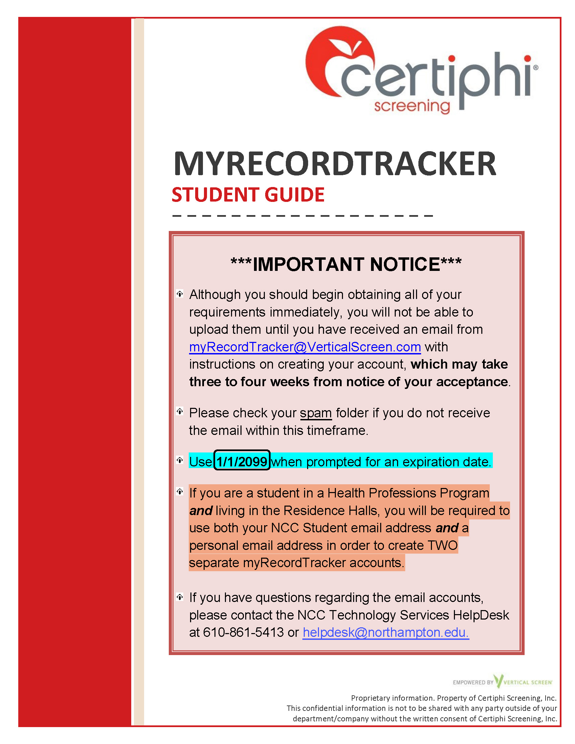
myRecordTracker® Instructions
Electronic Records system for uploading requirements
Follow instructions on Student Guide
Watch for an email from: myrecordtracker@verticalscreen.com
Email invitation will be sent to STUDENT email address – unless you are in another program which requires myRecordTracker® or a living in the Residence Halls

Slide 3
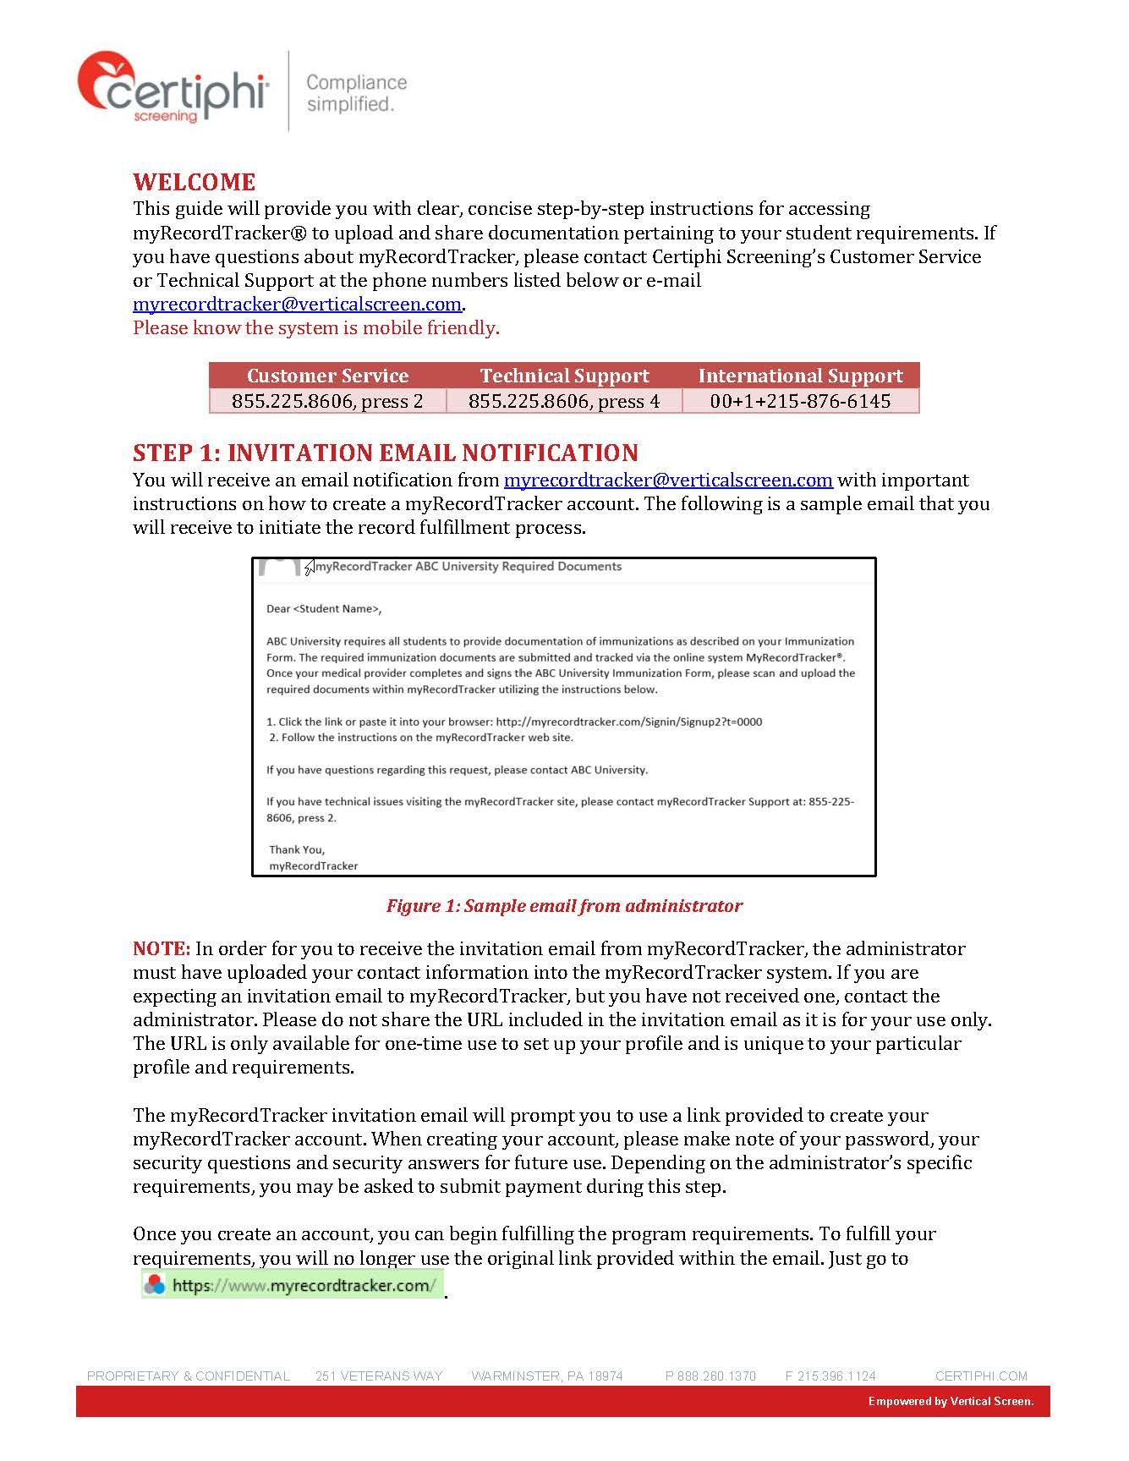
myRecordTracker® Instructions
Check “spam folder” and contact Program Director if still not received after 3 weeks
DO NOT use Google Chrome to create your account!
Create account and be sure to keep record of login information and security questions which must be at least 6 characters and are case sensitive
If you are in a Health Professions Program and living in the Residence Halls, you will need to create TWO separate myRecordTracker® accounts, one using your STUDENT email address, and one using your personal email address
You may have ADDITIONAL requirements to complete for the Residence Halls
https://www.myrecordtracker.com/Member/Profile?a=78EjxjR9%2Bq8%3D

Slide 4
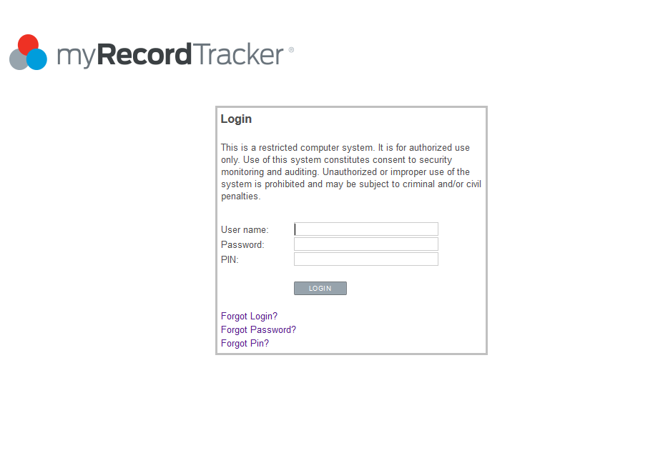
myRecordTracker® Login Page
Once your account is created, login at: www.myRecordTracker.com
Enter the Username, Password, and PIN used to create your account
Be sure to have the answers to your security questions handy (6 characters and case sensitive)

Slide 5
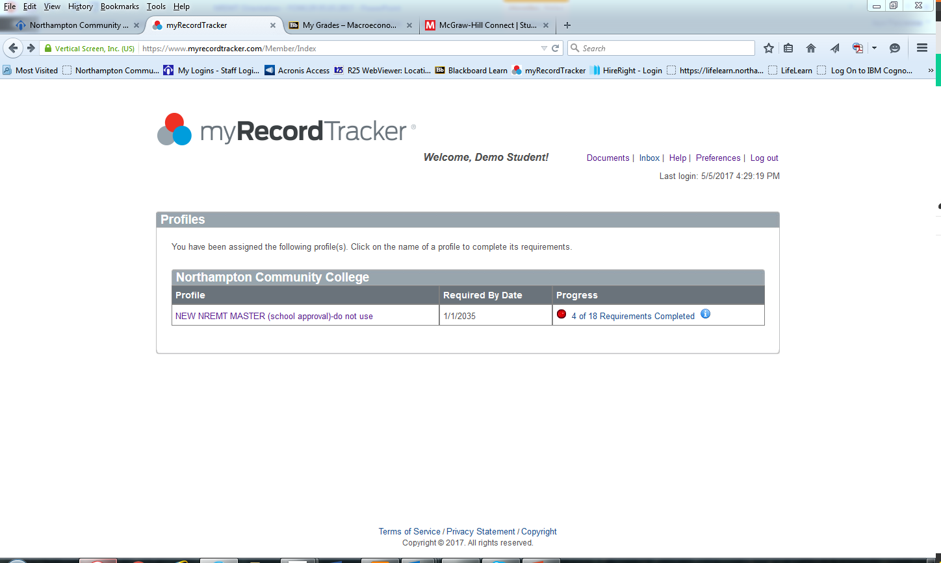
myRecordTracker® Home Page
All uploads are stored in “Documents” folder
Messages can be viewed in “Inbox”
Click “Help” for user guides or IT assistance
Click on profile name to access full list of requirements
Progress bar shows status of completion
NCC HEALTH CAREER CLASS

Slide 6
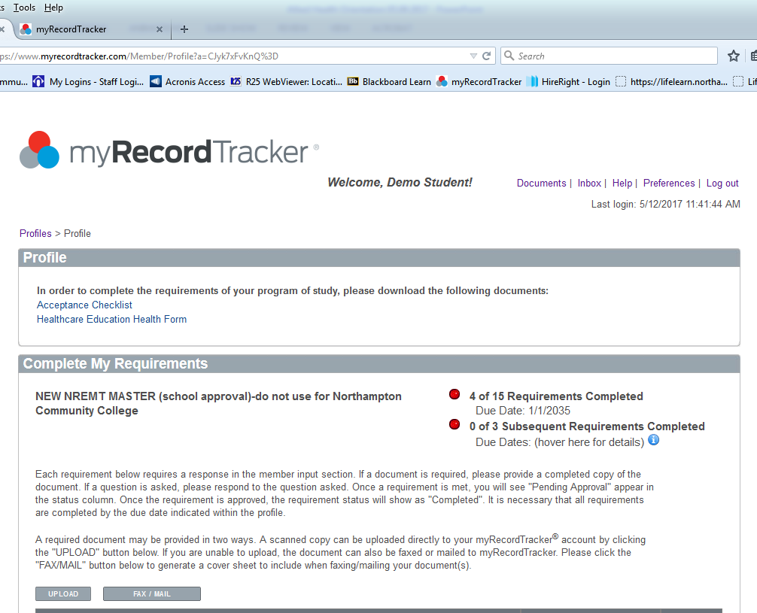
myRecordTracker® Available Documents
Program specific forms or documents may be available in the “Profile” section to download, such as the:
    Acceptance Checklist
    Health Form
  Also available at:
  https://www.northampton.edu/education-and-training/programs/health-professions-resources.html

Slide 7
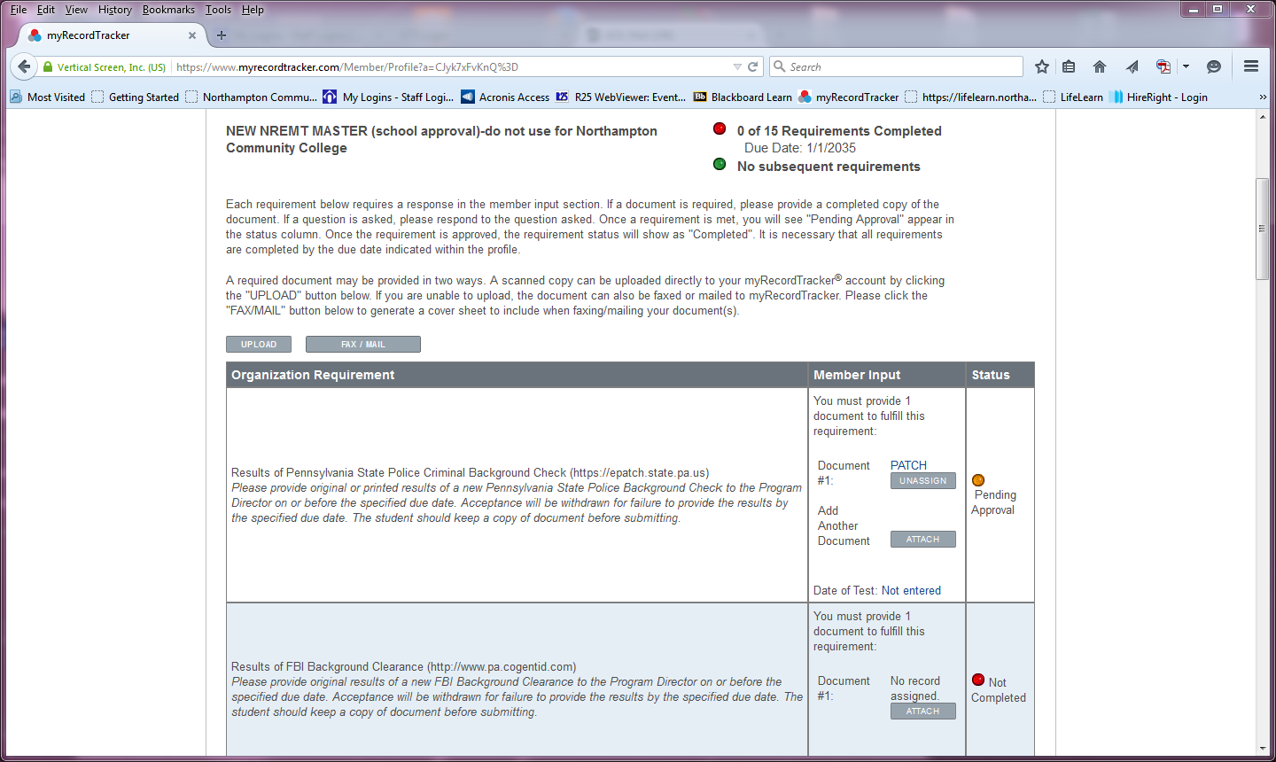
myRecordTracker® Profile
Status shows at top right
Subsequent requirements have a different due date (such as background clearances, flu shots, or drug screening)
Click on “upload” to submit documentation
Fax or regular mail options also available, if necessary

Slide 8
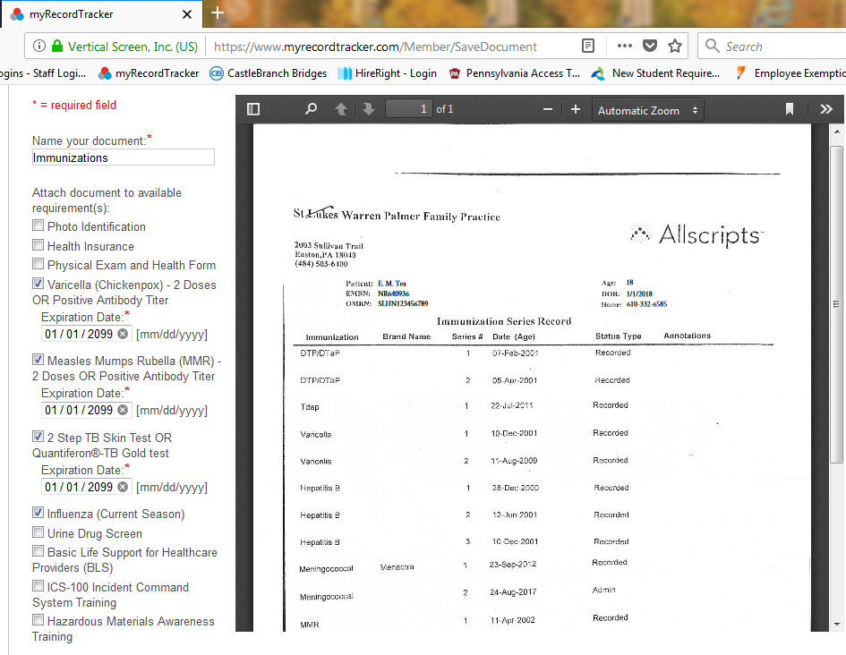
myRecordTracker® Uploading Documents
Name the document (with more than one letter or digit)
If the document contains several requirements (such as Varicella, MMR, Hep B, and TDAP), click each box to upload to multiple requirements
Use 1/1/2099 when prompted for an expiration date

Slide 9
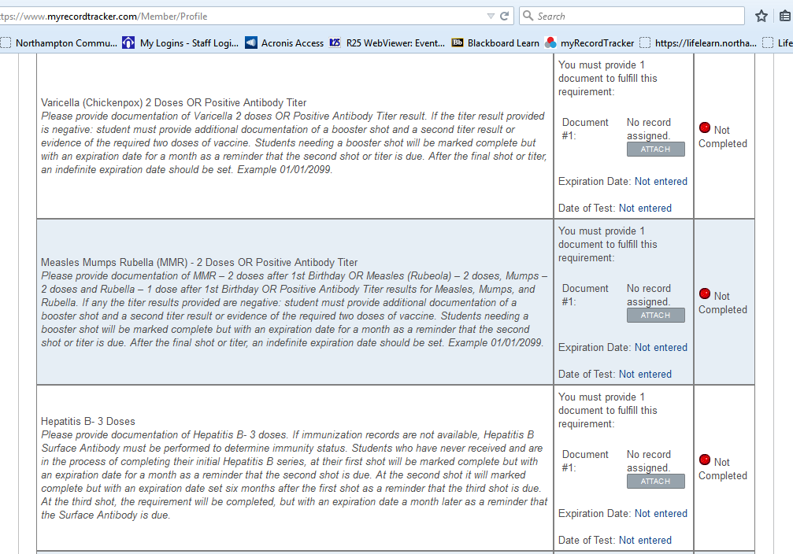
myRecordTracker® Requirement Descriptions
Each requirement is listed separately
Description will give more detailed information
Uploaded documents can also be attached to a requirement individually
Multiple documents can be uploaded to the same requirement

Slide 10
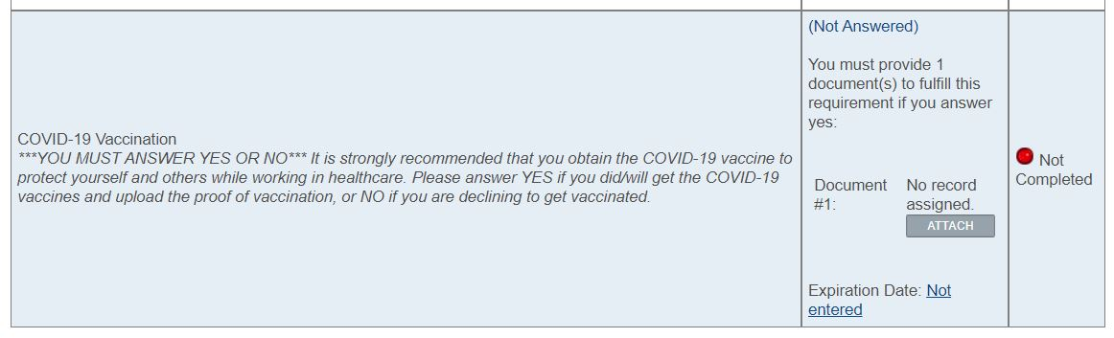
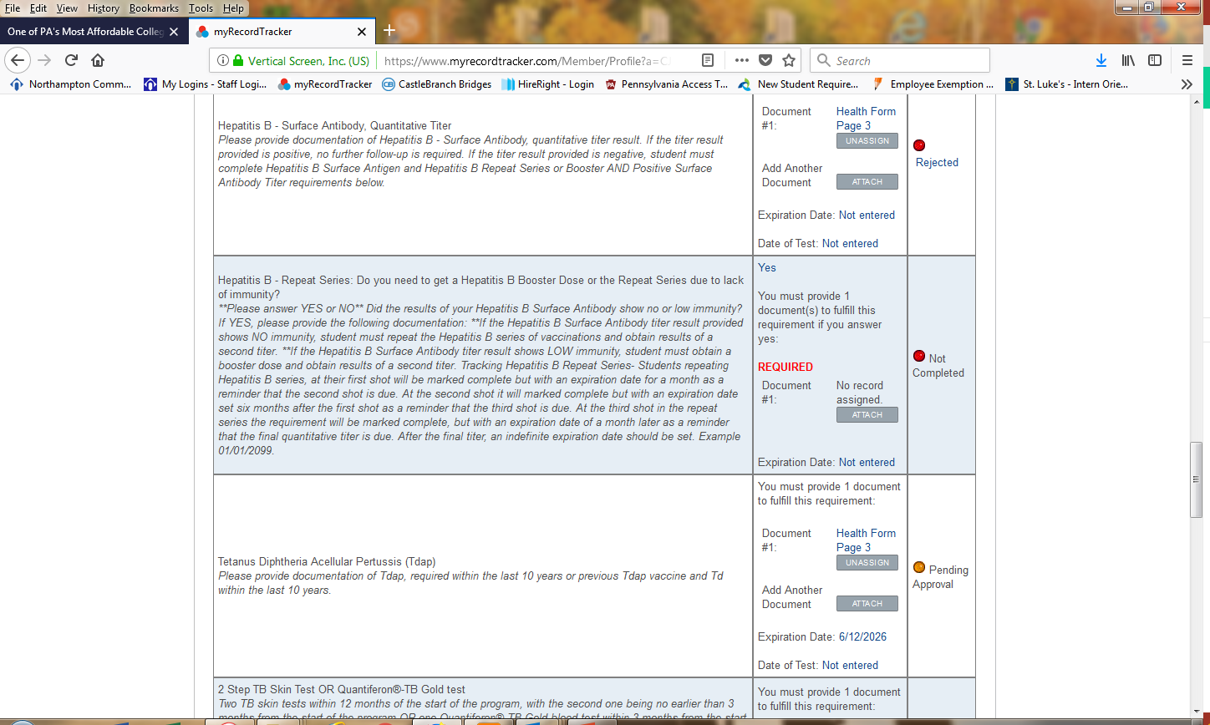
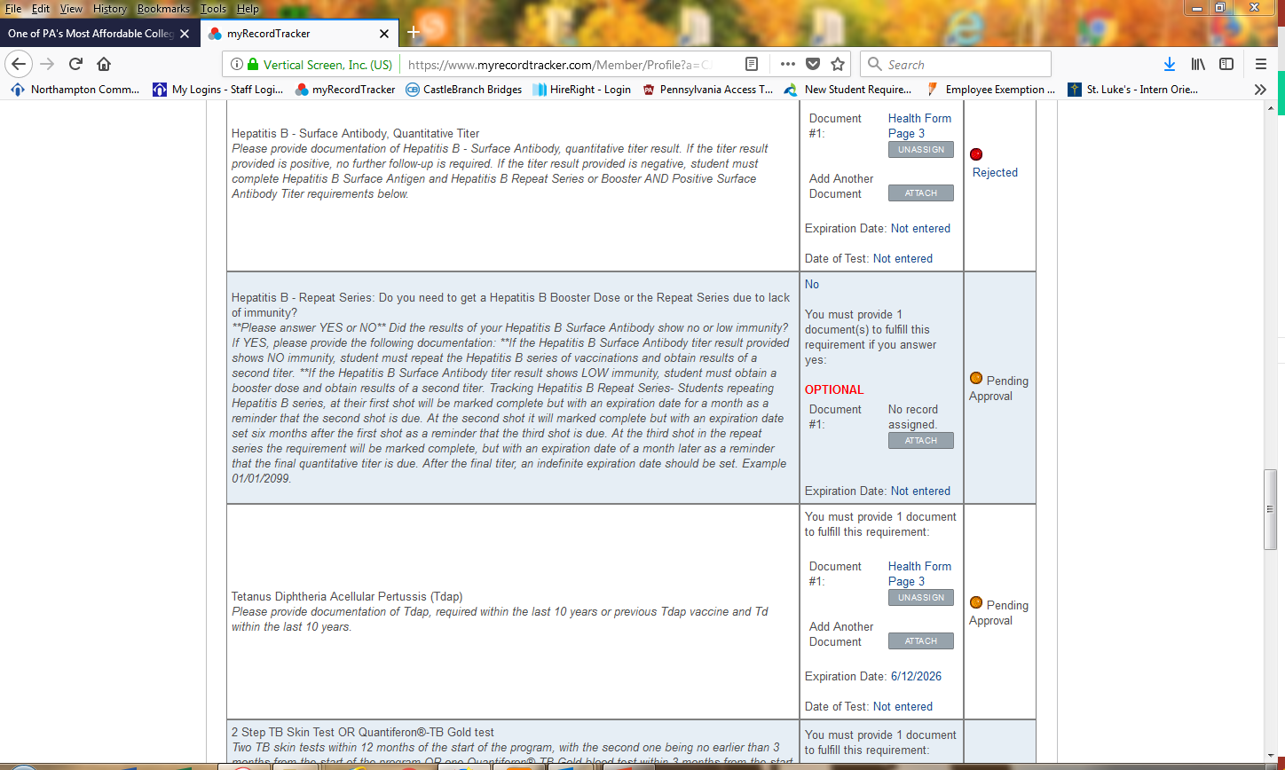
myRecordTracker® YES/NO QUESTIONS
Click on (Not Answered) to indicate YES or NO response
    YES =
        Positive Background
        Work for Healthcare Facility
    NO =
        Nothing on Clearances
        Don’t work in Healthcare
***ANSWER YES OR NO*** Is there anything that may come back on your criminal history that we should be aware of?
You are required to obtain the three criminal history clearances listed below, and there are additional steps that need to be followed. Please answer truthfully, and if you answer yes, please upload a detailed explanation letter of the charges as outlined on your Acceptance Checklist.

Slide 11
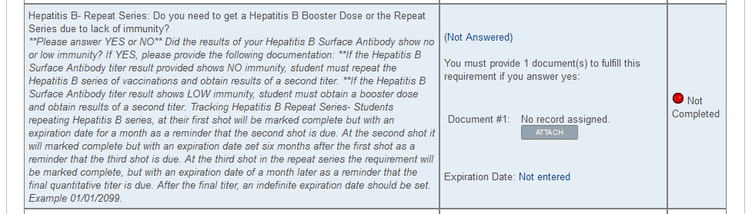
myRecordTracker® Hepatitis B Repeat Series
Pay special attention to Hepatitis B Repeat Series Requirements with the YES or NO question
You cannot answer this question until you obtain the Hepatitis B Surface Antibody Quantitative Titer Results which show your immunity level

Slide 12
myRecordTracker® Yes/No Hepatitis B Repeat
Answer YES to indicate you do need to get Hepatitis B Booster Dose or Repeat Series
  YES = NOT IMMUNE
Answer NO to indicate you don’t need to get any more doses since your titer result shows you have immunity
  NO = IMMUNE

Slide 13
myRecordTracker® Status Change
Once a document is uploaded, status under that requirement will immediately change to “Pending Approval”
Status will remain “Pending Approval” until reviewed by NCC Staff
Verification is a process…
**It is not immediate!**

Slide 14
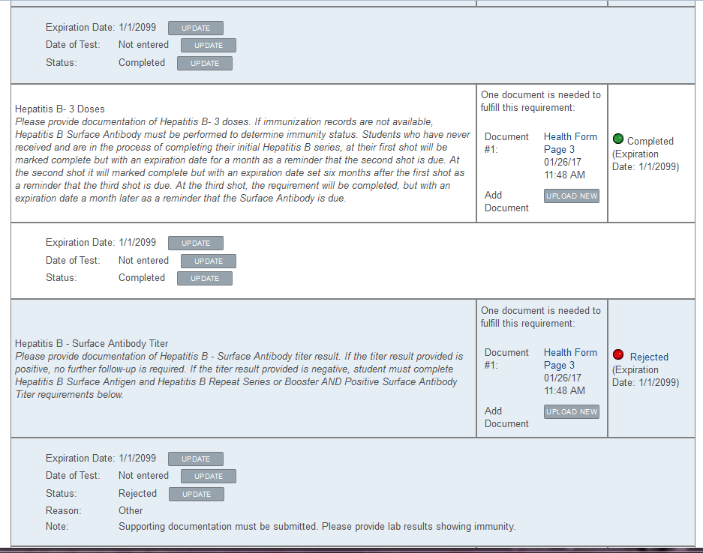
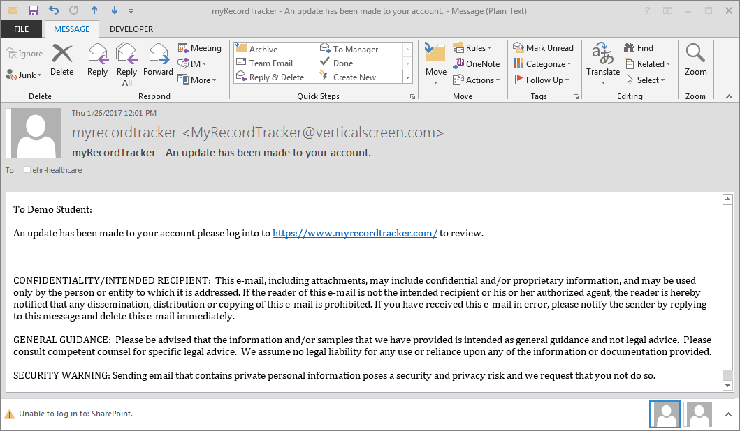
myRecordTracker® Status After Review
After NCC staff reviews documentation, status will change to:
      Completed
      Rejected
Watch for email notifications

Slide 15
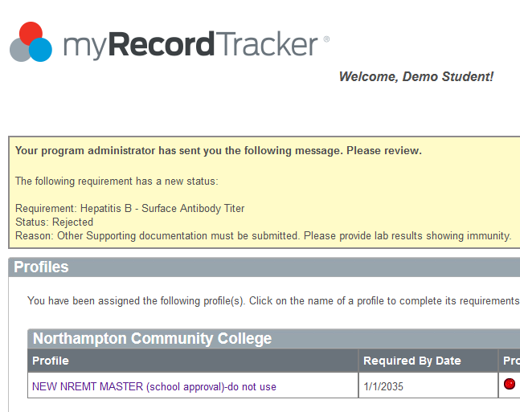
myRecordTracker® Status Update Message
If a requirement is rejected, a message will appear the next time you login to myRecordTracker®
Message will show a yellow box containing a detailed explanation of what is still needed to fix or fulfill that requirement

Slide 16
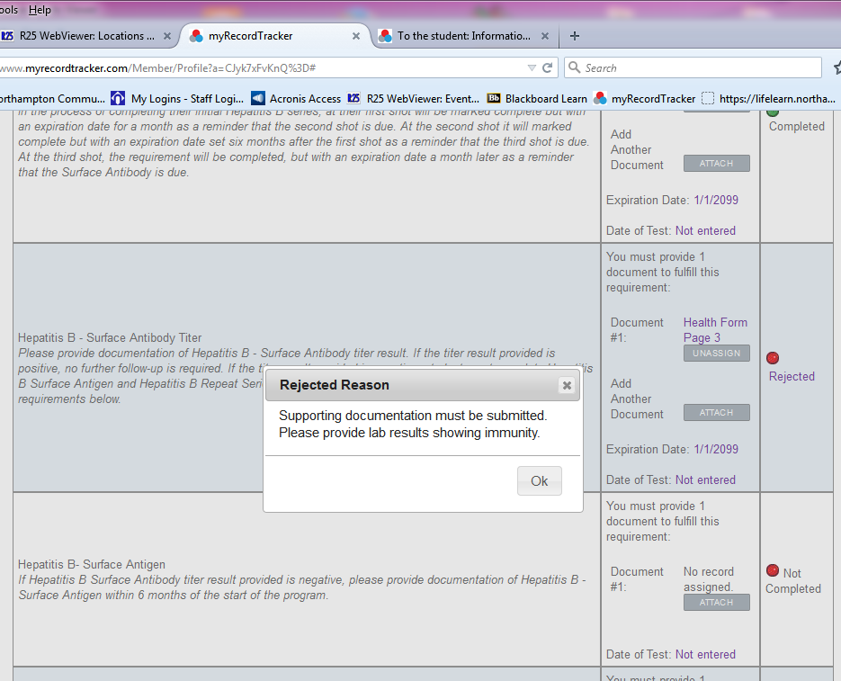
myRecordTracker® Rejected Messages
Once in student account, rejected messages can also be accessed by clicking on “Rejected”
A dialogue box will pop up with the explanation of what is needed to fulfill requirement – scroll to find
All requirements must be submitted by due date given

Slide 17
Remember…
Watch for an email from: myrecordtracker@verticalscreen.com
Don’t forget to check your “spam folder”
Do not use Google Chrome to create account!
If you still don’t get it, email Shawn Fortley at sfortley@northampton.edu and please include what program you are in!
Use 1/1/2099 for all expiration dates!

Slide 18

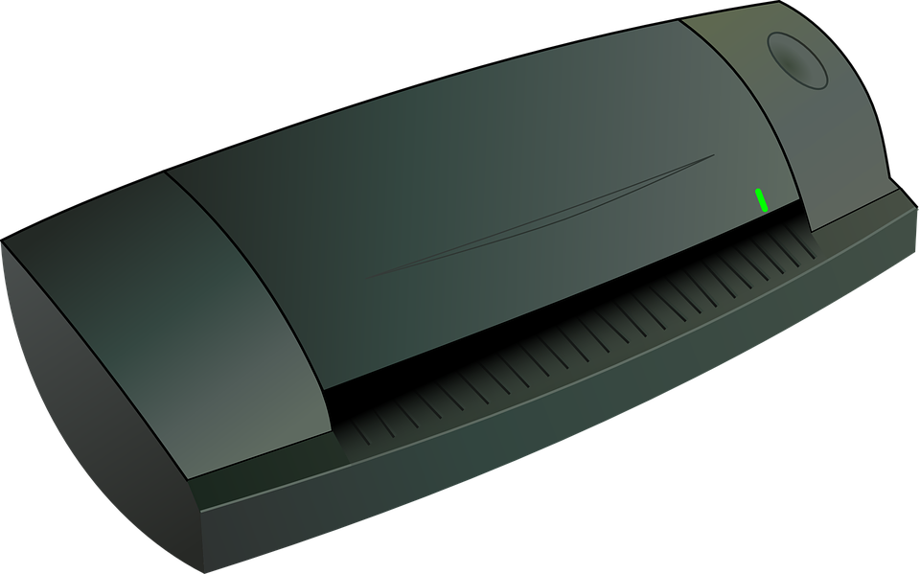
UPLOADING DOCUMENTS
Upload background clearances prior to submitting original documents to Program Director, if required
Documents may be uploaded by simply taking a picture with a smart phone or tablet
Must upload entire pages (no partial pages)
A laptop and scanner are available for student use at the Health Center:
College Center, Room 120

Slide 19

Regarding myRecordTracker®, contact Certiphi at 800-369-2612, ext. 2006
Regarding your STUDENT email, contact Helpdesk at 610-861-5413
Regarding your health requirements, contact the Health Center at 610-861-5365
Regarding your program requirements, contact your Program Director
Shawn Fortley at sfortley@northampton.edu

Slide 20


Slide 21


